Slide 1
Exploratory Data Analysis
Preparing Soil Moisture Forecasts for Automated Irrigation
Data Wrangling · Feature Engineering · LSTM Readiness

Slide 2
Project Context
Field Study at a Glance
We wired each randomized corn plot with soil moisture probes (6/18/30 cm), canopy temperature sensors, and a weather tower feeding a CR1000X datalogger.
Growers revisit irrigation every four days. We want a four-day VWC lookahead so they can act before stress sets in.
What makes this tricky? Three months of data but dozens of plots. The model has to mix short timelines with cross-field variety so one brain serves everyone.

Slide 3

Why Predict VWC Four Days Ahead?
Growers rely on the Soil Water Stress Index (SWSI) to plan irrigation. We forecast volumetric water content (VWC) four days ahead, then derive SWSI so agronomists can act before stress appears.
Accurate VWC forecasts keep the SWSI ratio inside the safe band for each plot.

Slide 4
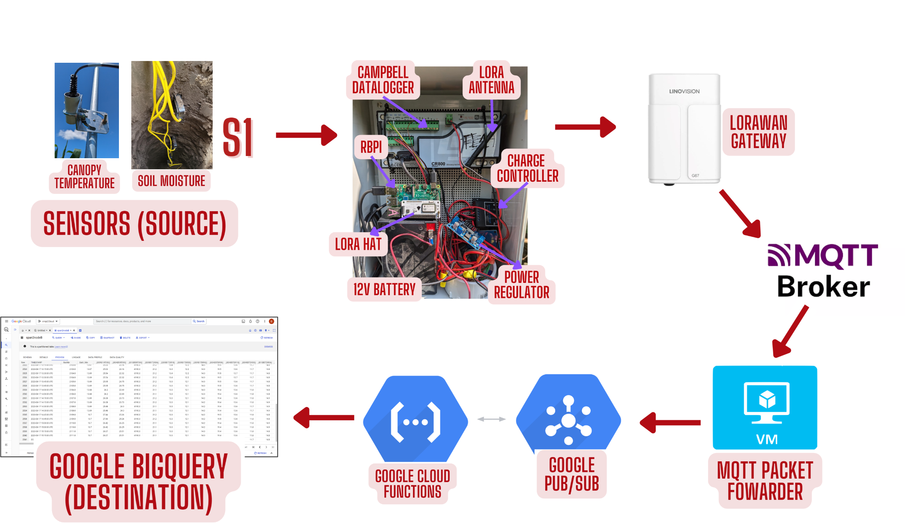
Sensor & Cloud Data Pipeline

Slide 5
What Did We Measure?
Every plot streams an hourly record from late July through September 2023. We ingested roughly 2,000 timestamps per sensor channel across seven RCBD blocks.
Sensor Stack
Spatial Scale
Soil moisture (6/18/30 cm), canopy temperature, weather tower, irrigation pulse totals.
Plots 2003–2015 share the crop but differ in irrigation strategy; the model must span them all.
Timeframe
Hourly readings roll up to daily averages, aligned with the four-day irrigation cycle.

Slide 6
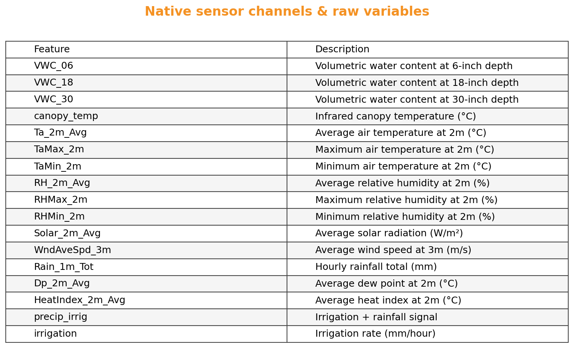
Native Channels Logged Each Hour
Why it matters
The notebook builds this list inside process_data_for_plot—weather, soil probes, and irrigation counters all land in the same dataframe.
If a sensor goes offline we update the code and this table together so downstream features never silently change.

Slide 7
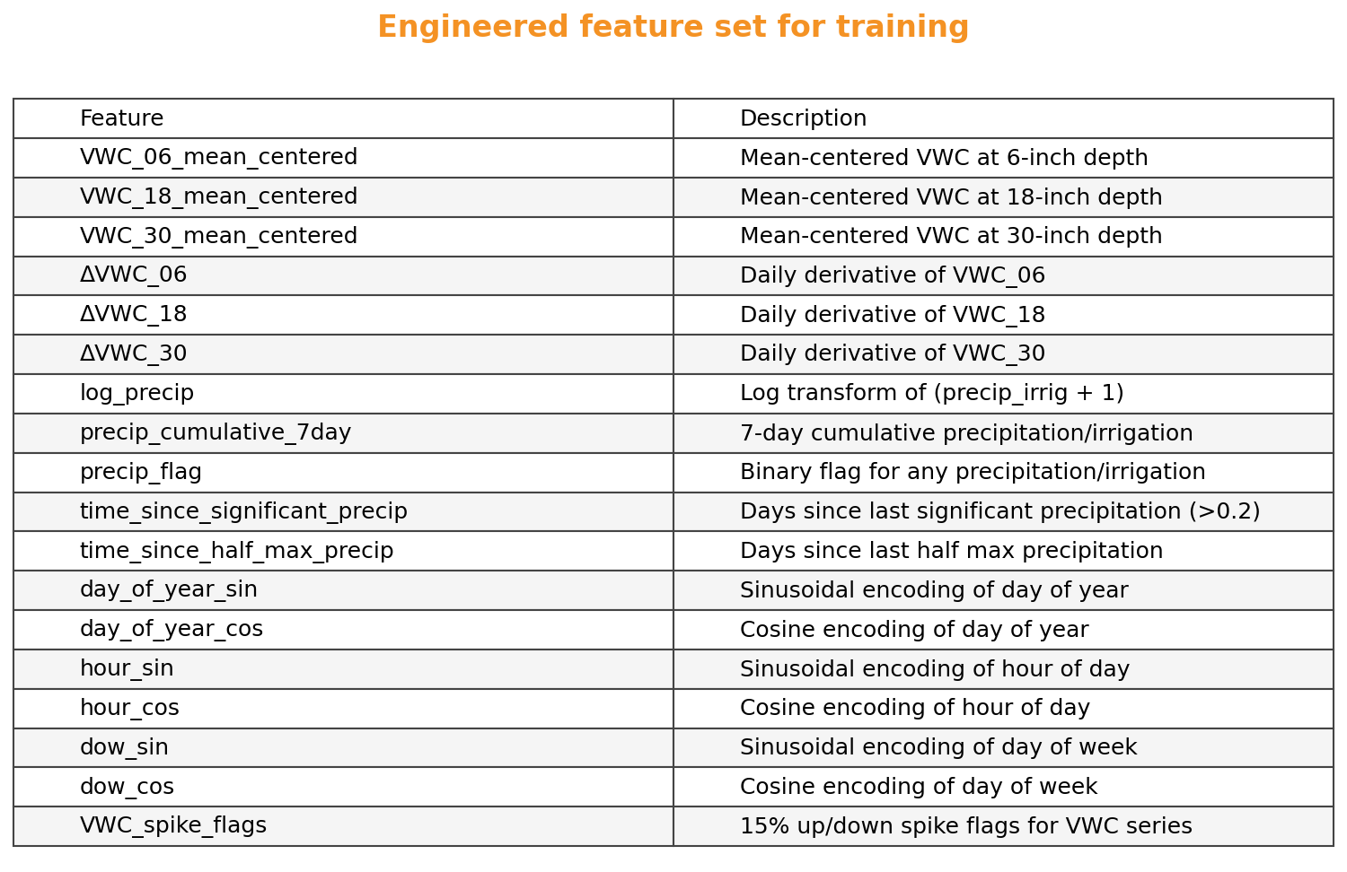
Engineered Features Fed to the Model
Feature recipe
The notebook adds spike flags, smoothed trends, derivatives, time-since-water counters, log-scaled precipitation, and sinusoidal time encodings—exactly the columns listed here.
If a feature isn’t in this table, it isn’t in the training dataframe; the graphic is our drift checklist.

Slide 8
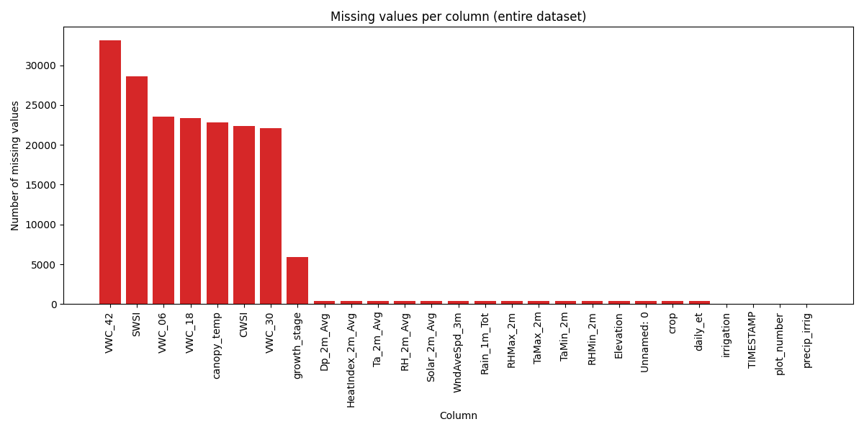
First Pain Point: Missing Hours Everywhere
Cables get chewed, solar panels cloud over, and irrigation knocks radios offline. In the raw export these outages show up as NaNs sprinkled across every channel. The next slide shows the best and worst raw VWC traces before cleaning.
What we learned from the raw export
Soil probes can go dark for days while the weather tower keeps logging. Power loss knocks out every channel at once, which is why the code trims dataset ends. Each plot recovers on its own schedule, so we avoid borrowing from neighbours.

Slide 9
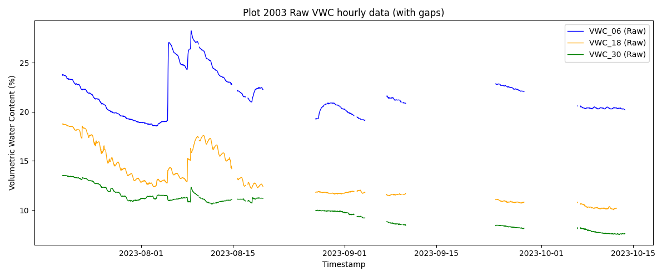
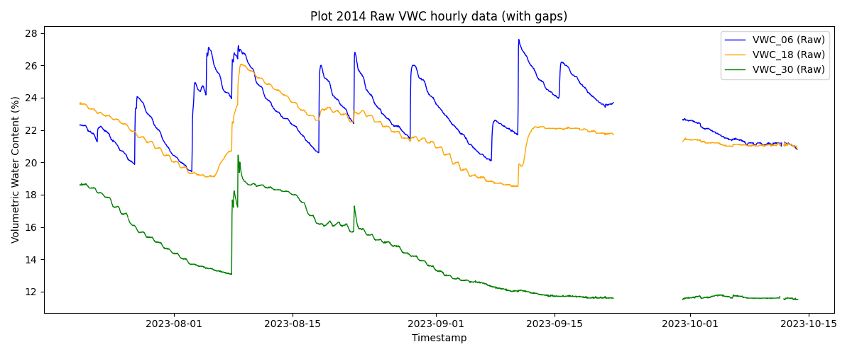
Raw VWC Before Any Cleaning
Here are two plots straight from the logger. Plot 2003 is the worst case—long outages and jagged spikes. Plot 2014 is comparatively clean but still loses hours after storms.
Plot 2003 · Worst gaps and sensor noise.
Plot 2014 · Cleaner but still missing storms.

Slide 10
Cleaning Before Feature Work
Before we engineer any features the notebook runs four quick steps (all inside process_data_for_plot) to line up every plot and prevent duplicate readings from skewing the daily averages.
1. Trim outages
2. Drop duplicates
Clip the dataset ends until every column has data.
Remove timestamps replayed after logger reboots.
3. Set index
4. Resample daily
Sort by TIMESTAMP so resampling and windowing stay stable.
Aggregate hourly readings to daily means for the four-day horizon.

Slide 11

Gap Filling with PCHIP
We interpolate daily VWC gaps with SciPy’s Piecewise Cubic Hermite (PCHIP) spline. It keeps the curve monotonic between known points so dry-down periods stay smooth.
Hermite basis functions blend neighbouring values and slopes so the fill extends the real dry-down pattern.
Reality check: right now we fill every day, even the wet ones. That flattens the irrigation spikes. Masking days with ≥5 mm of water before filling would keep those jumps intact.

Slide 12
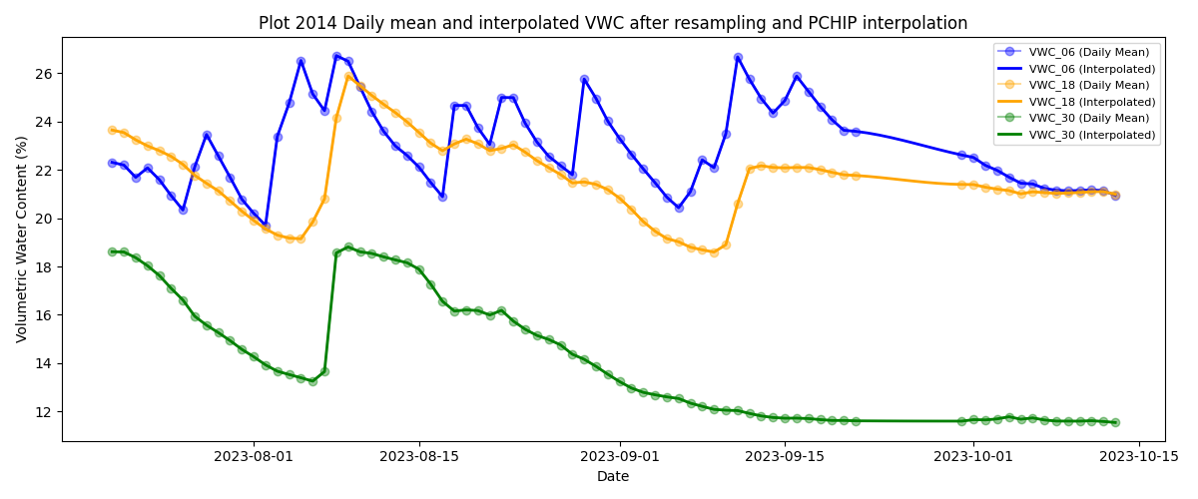
PCHIP Fills VWC Gaps Smoothly
Daily averages for plot 2014 after interpolation. Because we currently fill every day, irrigation spikes get softened—masking wet days before PCHIP would preserve those jumps.

Slide 13

Smoothing & Daily Change Features
After interpolation we smooth each depth with a 20-day Savitzky–Golay filter so the signal reflects crop-scale trends instead of probe jitter.
ΔVWC captures how quickly the profile is drying or being refilled.
Positive ΔVWC flags irrigation or rain recharge events.
Negative ΔVWC matches evapotranspiration drawdown between irrigations.

Slide 14
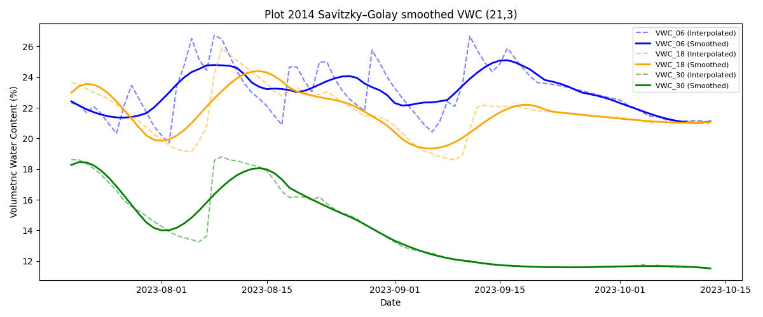
Savitzky–Golay Reveals the Trend
Smoothed curves (solid) for plot 2014 follow the interpolated series (dotted) while stripping sensor chatter. These become the basis for derivative features.

Slide 15
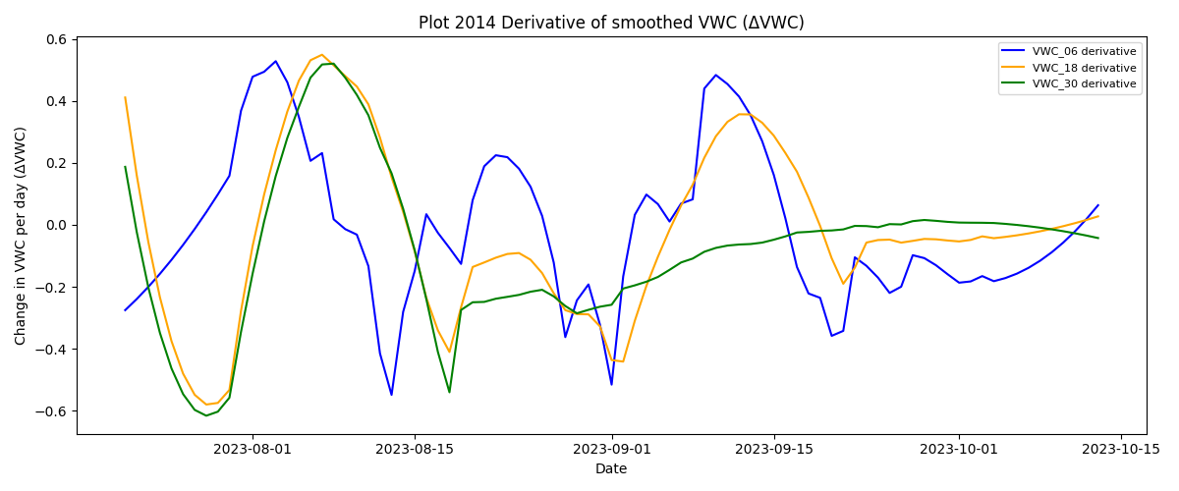
ΔVWC Highlights Recharge Events
After smoothing, the notebook takes a simple first difference to see how fast moisture is changing. Positive spikes flag irrigation or rain; negative runs trace evapotranspiration between events. If the signal ever gets noisy, we could switch to centred or multi-day slopes.

Slide 16
Flagging Spikes for Irrigation Awareness
Sudden jumps in VWC usually mean we irrigated, injected fertilizer, or caught a thunderstorm. The model needs to recognize these events explicitly.
Spike up: the code marks a recharge when VWC today is 1.15× yesterday.
Spike down: a 15% drop flags drainage or unplugged probes.
Flags are computed per depth so shallow and deep responses stay distinct.
15% came from the 2023‑08‑03 fertigation run. If we see missed events, we can tune the multiplier in process_data_for_plot.

Slide 17
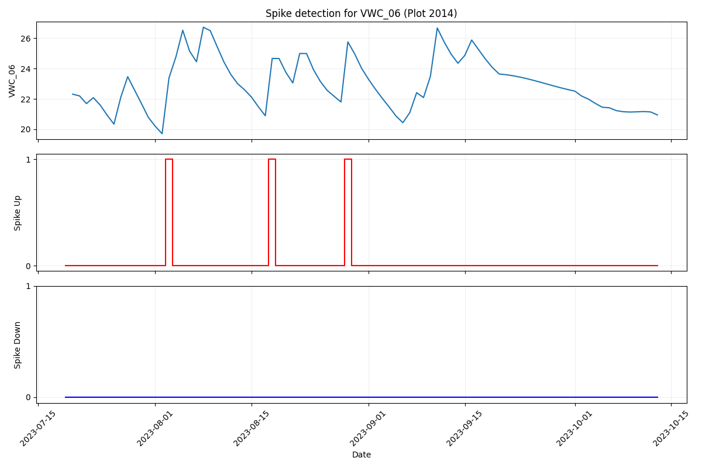
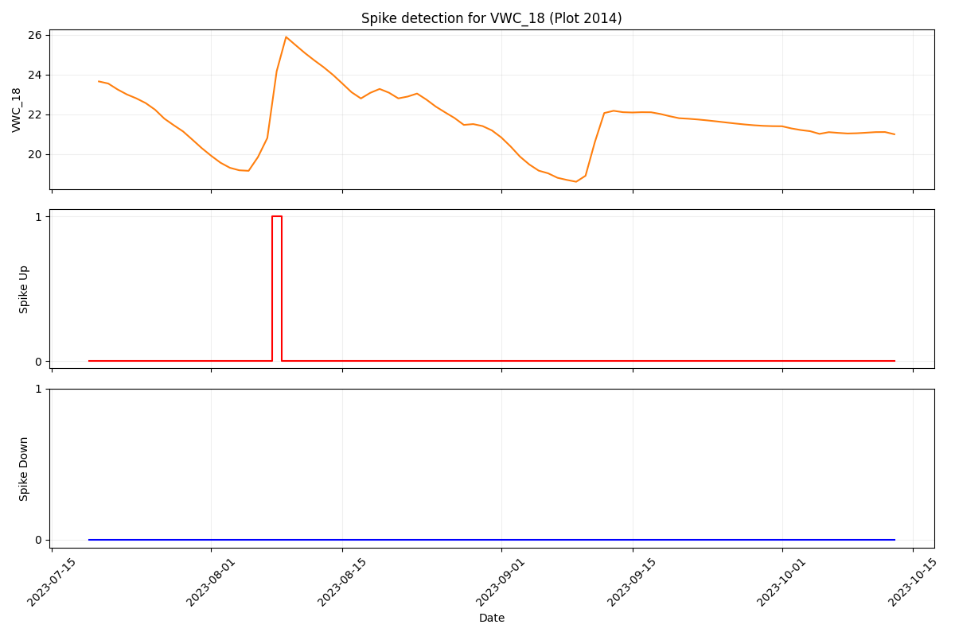
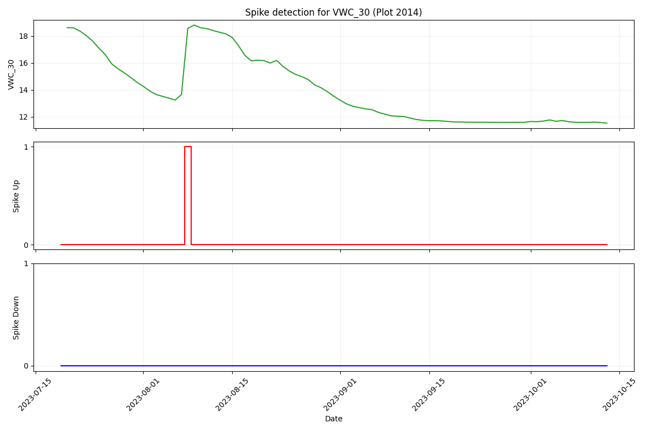
Spike Flags by Depth · Plot 2014
Depth 6 cm reacts almost immediately after irrigation.
Depth 18 cm lags by a day but still shows a clear spike.
Depth 30 cm keeps the irrigation signal even though it is dampened.
These binary flags line up with the ΔVWC spikes we engineered earlier, giving the model a crisp indicator of irrigation timing at each depth.

Slide 18
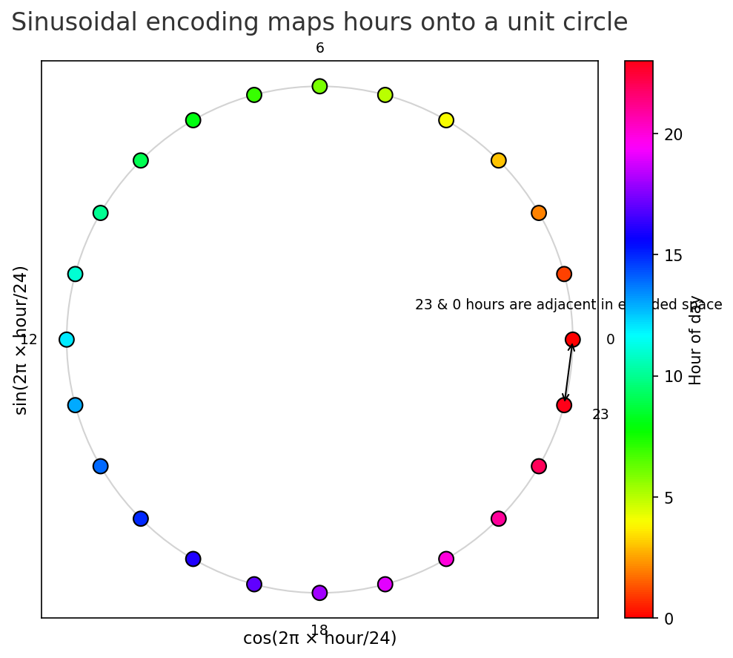

Temporal Features & Safe Scaling
We store three water-history features: days since the last ≥0.2 in event, a 7-day precipitation+irrigation sum, and log(precip_irrig + 1) so tiny pulses survive scaling.
Sinusoidal encodings keep midnight next to 11 pm and preserve daily cycles without jumps; the code adds sin/cos terms for hour, day, and day-of-week.
A 30% buffer keeps scaled features inside [0,1] even when validation plots see more water than training.

Slide 19
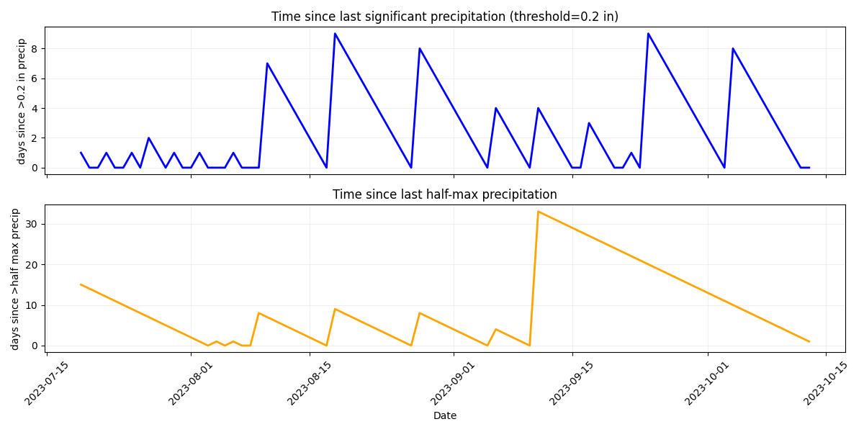
Days Since Water — Plot 2014
The code resets the counter whenever precip_irrig tops 0.2 in (≈5 mm), so the stair steps match the four-day irrigation rhythm.

Slide 20
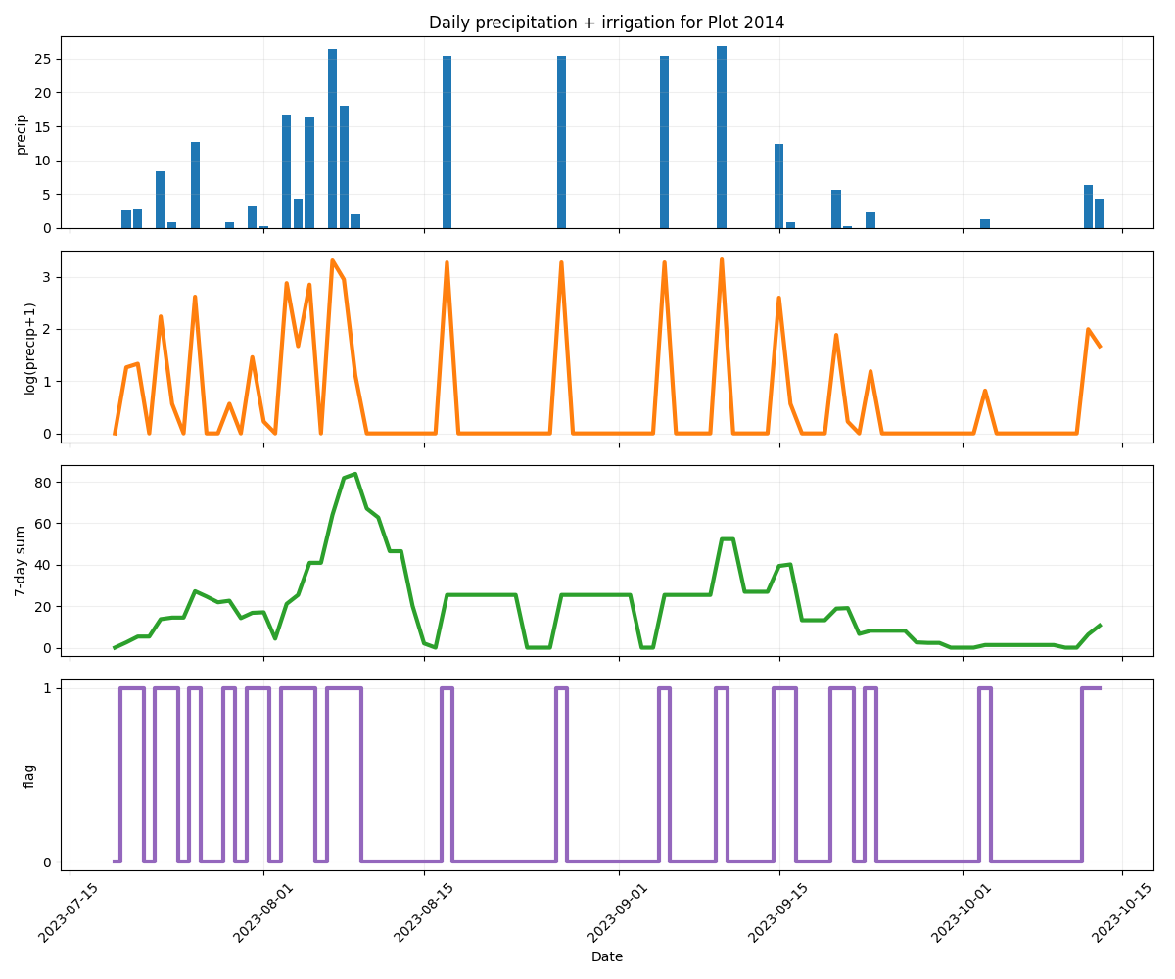
Water Supply Features After Scaling
Buffered MinMax scaling keeps the transformed precipitation signals inside [0,1] even when unseen storms arrive.

Slide 21
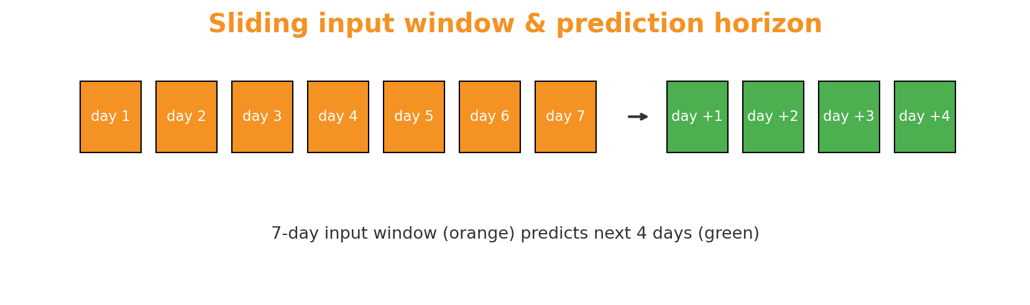
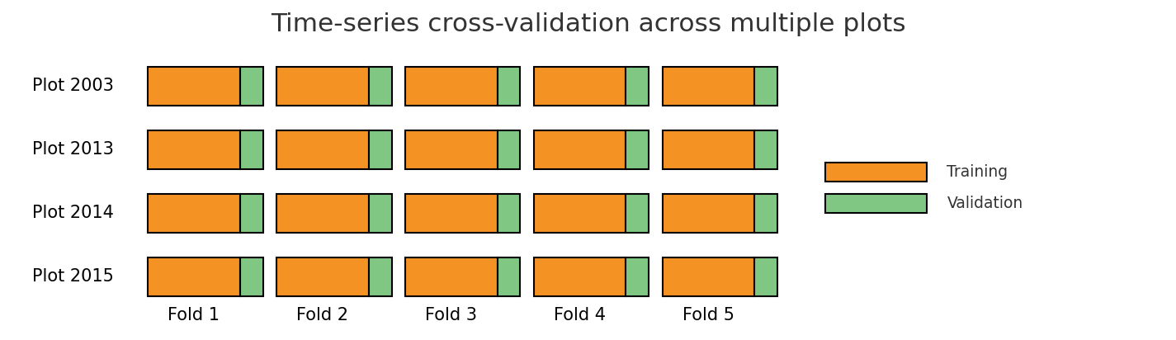
How We Feed and Validate the Model
Seven days in, four days out. We currently slide the window forward one day at a time, so forecasts overlap.
TimeSeriesSplit keeps each plot chronological: orange windows train, green windows validate across the RCBD blocks.

Slide 22
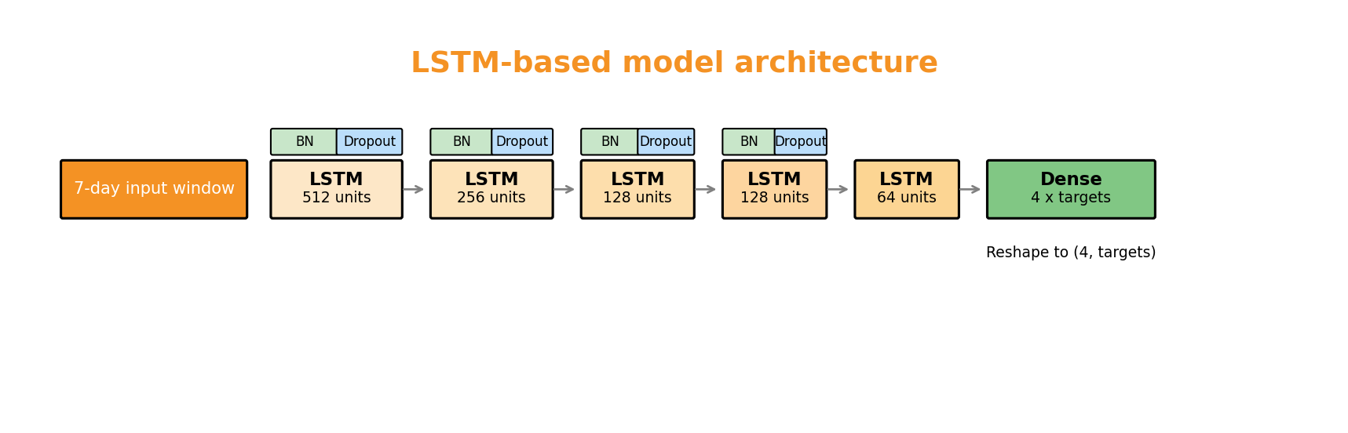
LSTM Stack Used in Training
The notebook builds the full stack below: LSTM layers with 512 → 256 → 128 → 64 units, batch norm, and dropout, then a dense head reshaped to four forecast days × three depths.
Training uses Adam with exponential decay (start 0.001) and MSE loss across five TimeSeriesSplit folds so weights see every plot.

Slide 23
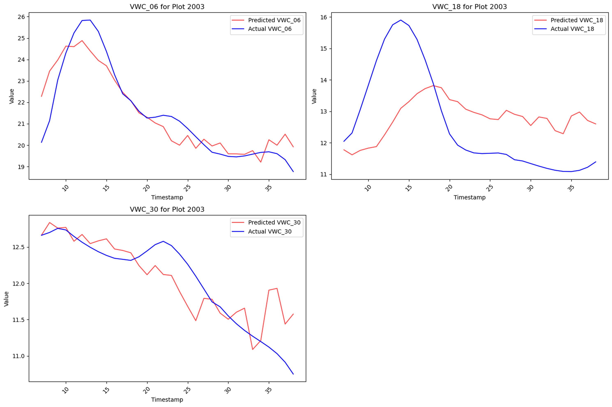
Hold-Out Forecast Example
Sliding the trained network across a hold-out plot shows where it succeeds and fails. It catches some four-day moisture swings but can miss irrigation timing that never appeared in training plots.
Example below: predictions (orange) vs. actuals (blue) for plot 2003 across sequential four-day horizons.

Slide 24
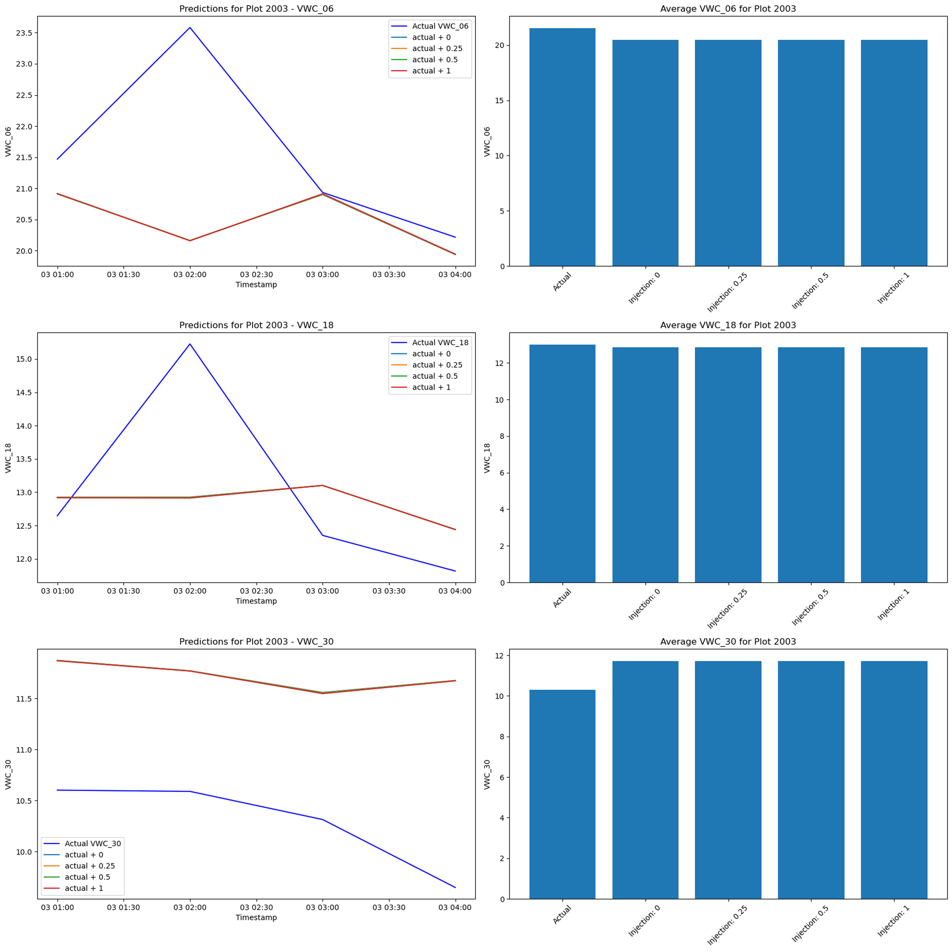
Irrigation Injection Experiment
We injected extra irrigation into hold-out sequences to test whether the model would predict higher VWC. Because injections happen after scaling, the added pulse sits near 1.0 in both cases and the forecast barely moves.
Until we rescale the injection or add stronger irrigation features, the network cannot learn the sensitivity growers need.

